Slide 1


Azure Kubernetes Service
Accelerate Growth on Cloud

Slide 2
Agenda
What is POD
DEMO on Deployments
Deployments
Demo on Replica sets
POD Lifecycle
Replica sets

Slide 3
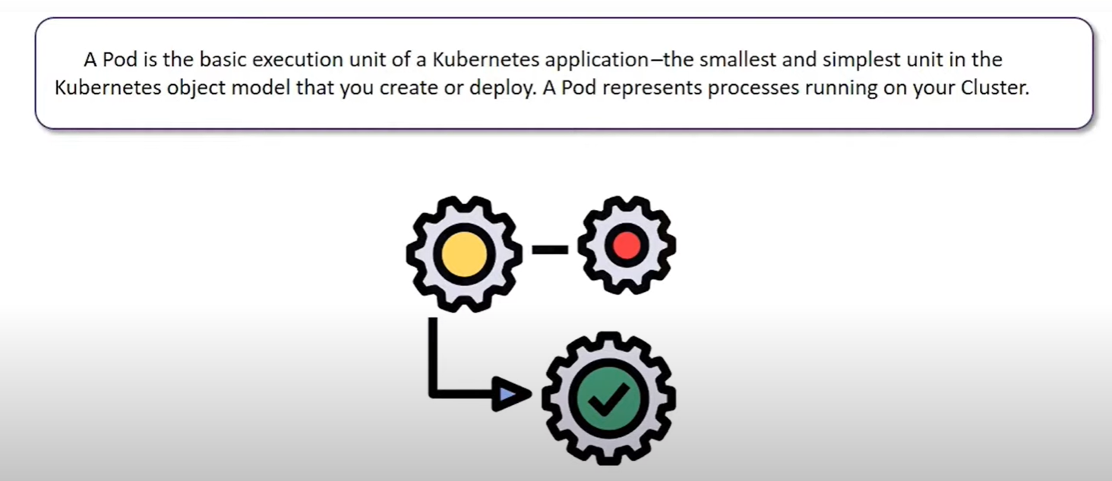
What is POD
Copyright (c) 2019. Blazeclan Technologies Pvt. Ltd.

Slide 4
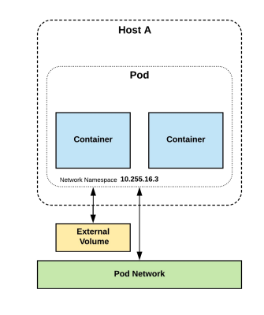
What is POD
Pods are one or MORE containers that share volumes, a network namespace, and are a part of a single context
They are also Ephemeral
Copyright (c) 2019. Blazeclan Technologies Pvt. Ltd.

Slide 5
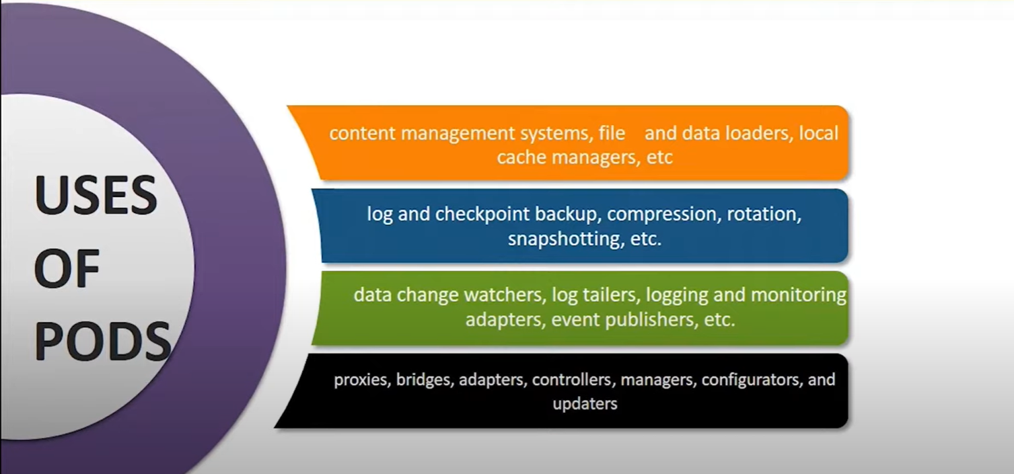
What is POD
Copyright (c) 2019. Blazeclan Technologies Pvt. Ltd.

Slide 6
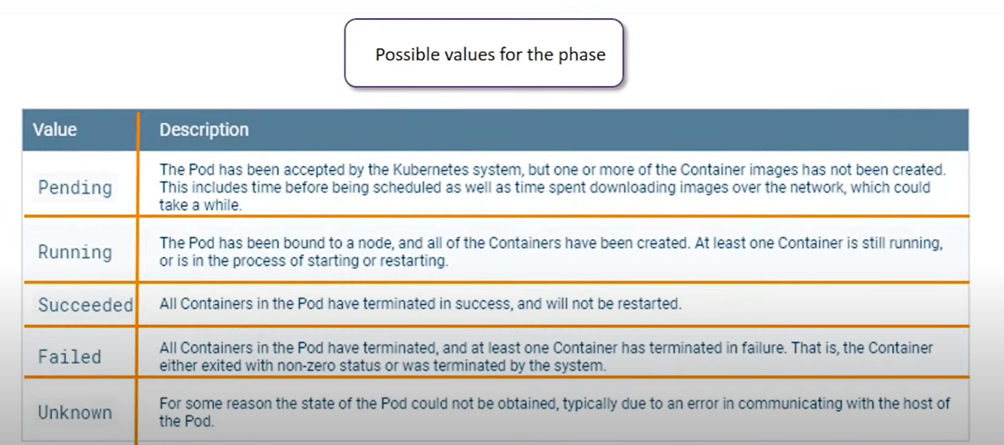
What are POD Phases
Copyright (c) 2019. Blazeclan Technologies Pvt. Ltd.

Slide 7
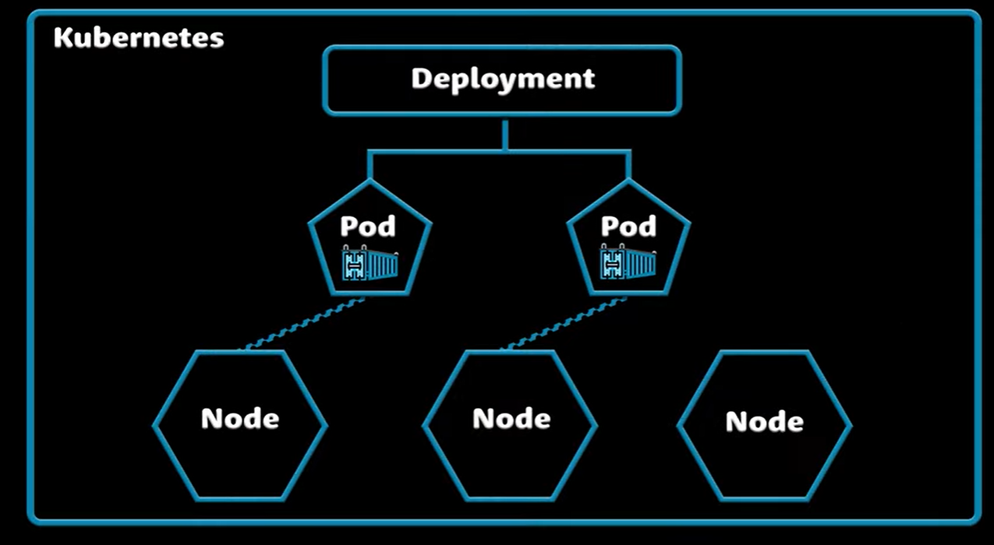
What is POD
Copyright (c) 2019. Blazeclan Technologies Pvt. Ltd.

Slide 8
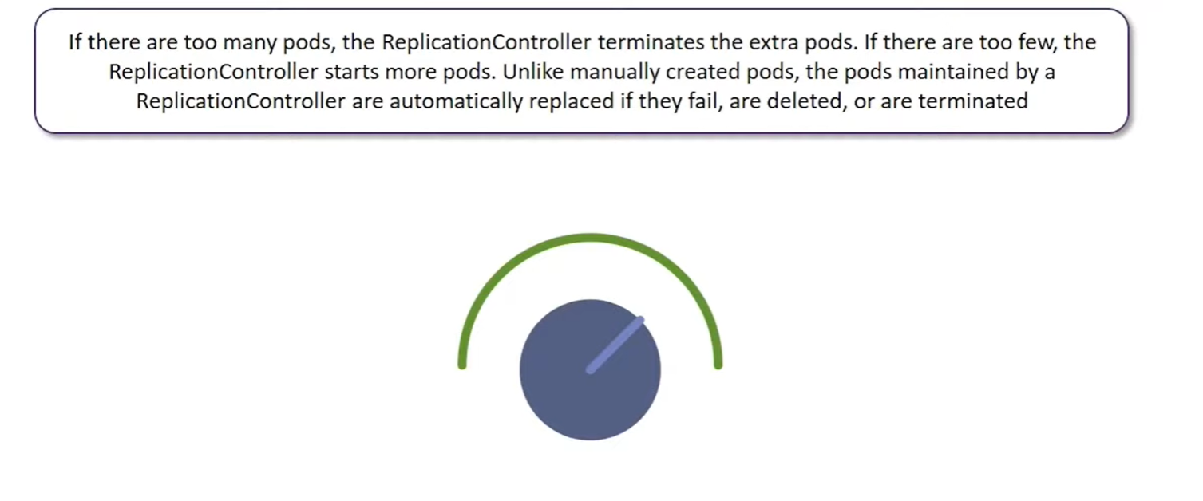
Replication Controllers

Slide 9
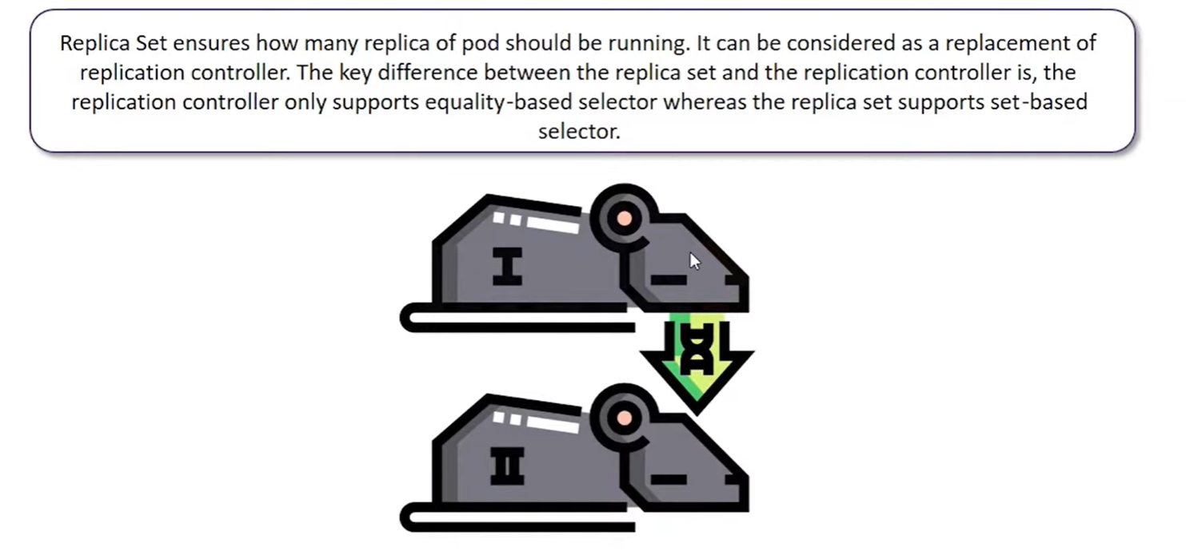
Replica Sets

Slide 10
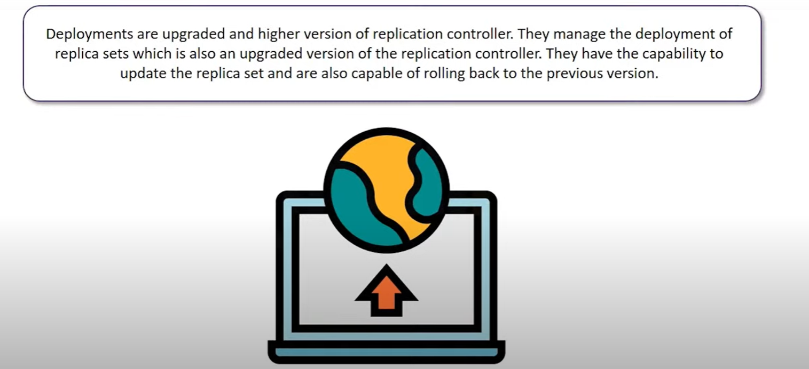
Deployments

Slide 11
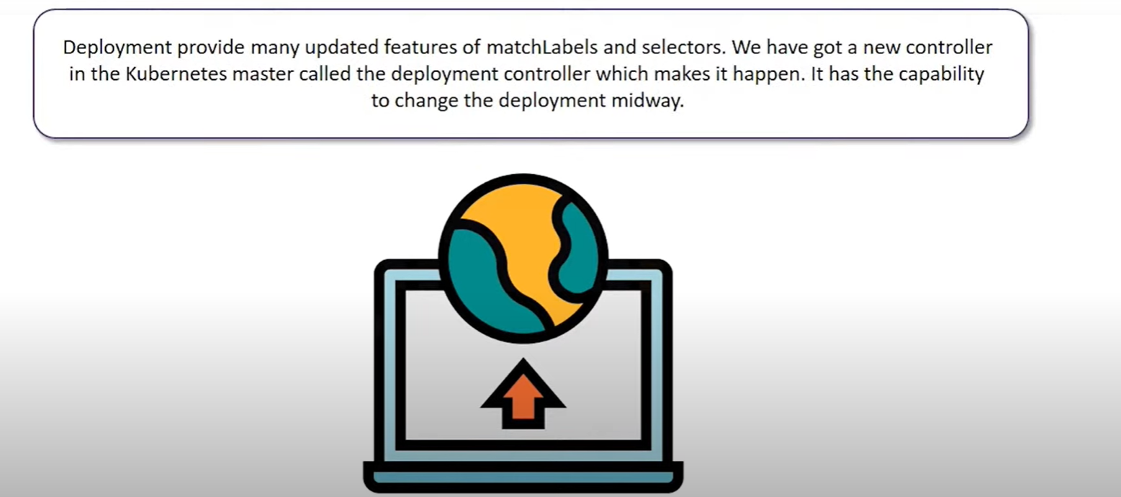
Deployments

Slide 12
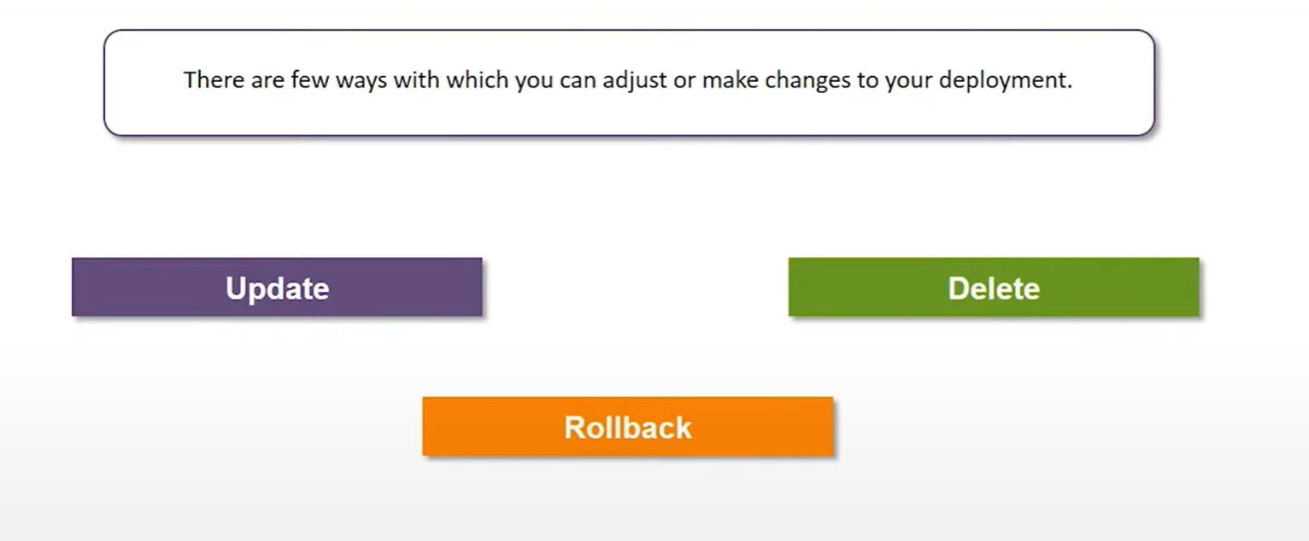
Deployments

Slide 13
Deployments
UPDATE :
The user can update the Ongoing deployment before it is completed, In this the existing deployment will be settled and a new deployment will be created.
DELETE:
The user can Pause/Cancel the deployment by deleting it before it is completed. Recreating the same deployment will resume it.
ROLL BACK:
We can Roll back the deployment or the deployment in progress. The user can create or update the deployment by using DeploymentSpec.PodTemplateSpec = oldRC.PodTemplateSpec.

Slide 14
DEMO

Slide 15

thank you
Notes:
Do Not edit this Slide, This is Thank you in motion

